Slide 1
Entity relations
Job →skill
Skills → job
Skills → skills
Job →job

Slide 2
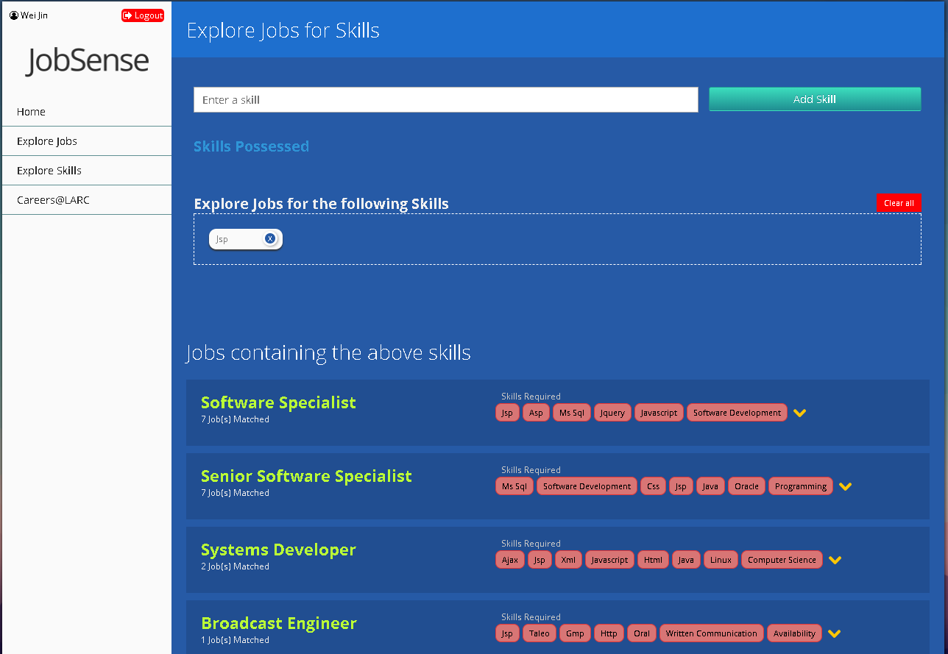

Slide 3
